Slide 1
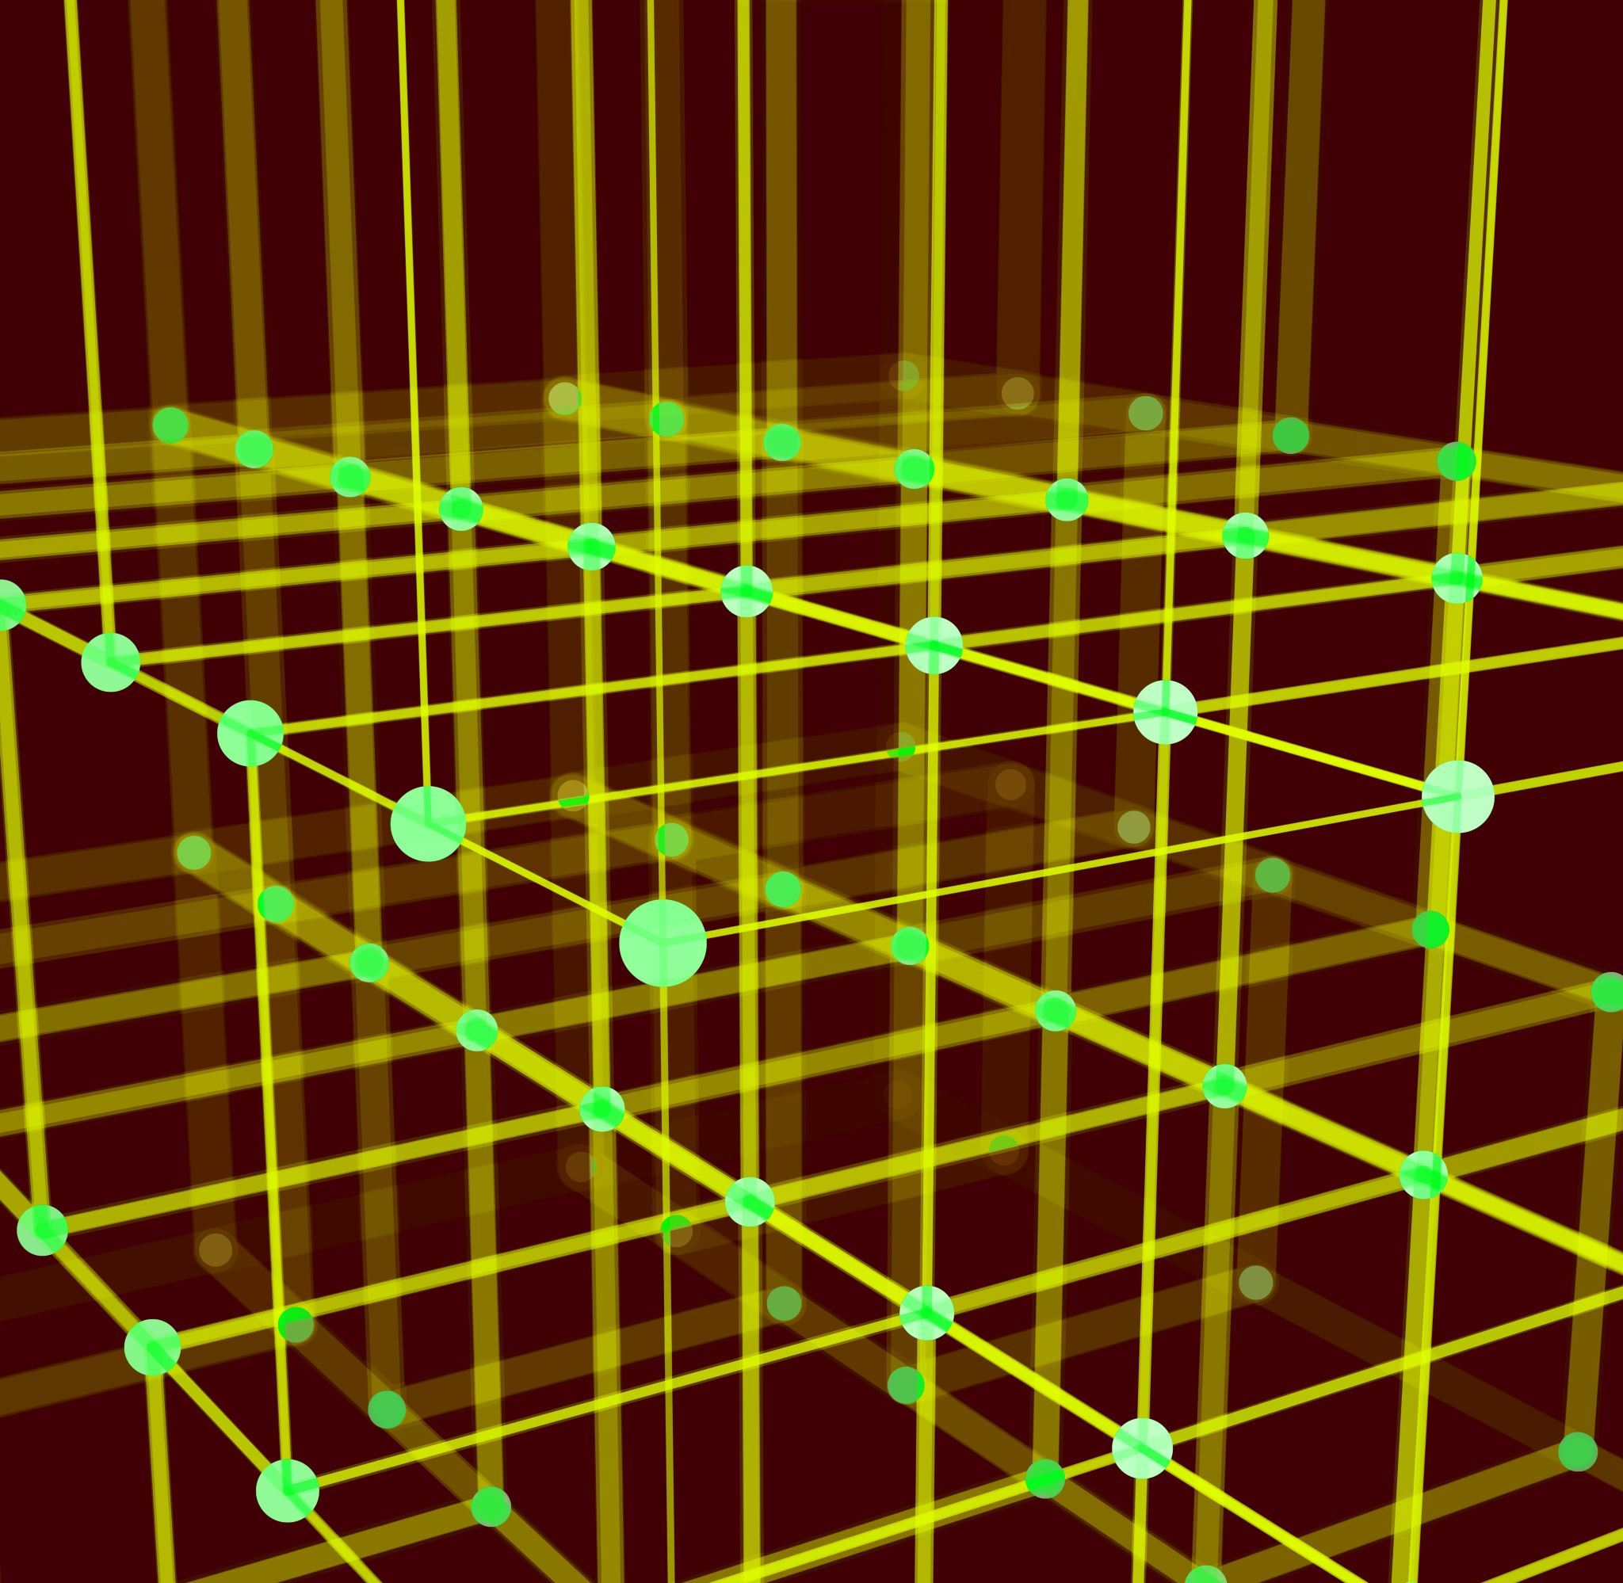
Clustering Methods

Slide 2
Fingerprint
This method less likely to produced false positive.
Removing/Fix whitespace
Change uppercase into lowercase
Remove punctuation and control character
Normalized diacritics (accents)
Split up all strings (words) and sort them alphabetically
e.g. "Cruise, Tom" and "Tom Cruise"=> cruise tom

Slide 3
N-Gram Fingerprint
Set the value of n according to our data or choice
Removing/Fix whitespace
Remove punctuation and control character
Normalized diacritics (accents)
1-gram fingerprint organize all the letters in the cell into alphabetical order
e.g. paris => aiprs
2-gram will find all the two-character segments, remove duplicates, alphabetize them, and join them back together
e.g. paris => pa ar ri is => arispari
e.g.banana => ba an na an na => anbana
help match cells that have typos, or incorrect spaces

Slide 4
Phonetic Fingerprint
It identify word that sound similar when they pronounced.
This type of error comes when they not know the spelling or misunderstood.
e.g. Pyscho => sicho
a word with an “S” might be a mistype of a word with a “Z”
There is mainly 4 phonetic algorithms:-
Metaphone3
Cologne-phonetic
Daitch-Moktoff
Beider-Morse
e.g.to/two/too , pray/prey

Slide 5
Metaphone3 Fingerprinting
It can work with non-English words
Voiced and un-voiced consonant pairs
'CH' and 'SH' -> 'X',
'D' and 'T' -> 'T'
the sound that is spelled as "TH" in English is encoded to '0'
e.g.“Reuben Gevorkiantz” => “Ruben Gevorkyants”

Slide 6
Cologne Fingerprinting
Cologne Phonetics, also called Kölner Phonetik
It assigns a sequence of digits
It is mainly for German pronunciation
conversion to upper case
Good Morining = > Guten Morgen -> GUTENMORGEN -> 40206607406

Slide 7
Daitch-Moktoff
It was created by Randy Daitch and Gary Mokotoff of the Jewish Genealogical Society.
It is a phonetic algorithm for Slavic and Yiddish words
Names are coded to six digits
When a surname consists of more than one word, it is coded as if one word.
A, E, I, O, U, J, and Y are always coded at the beginning (Not always)
Adjacent letters have the same code number, they are coded as one sound
e.g. TOPF,=> not coded TO-P-F => TO-PF

Slide 8
Beider-Morse
It is a version of Daitch-Mokotoff that is slightly more strict.
It is very intelligent algorithm, compared to Metaphone3
Determines the language from the spelling of the name
Applies phonetic rules to identify the language and translates the name into phonetic alphabets
Calculating the Approximate Phonetic Value
Calculating the Hebrew Phonetic Value

Slide 9
Nearest Neighbor Method
This clustering methods are slower than key collision methods.
It is also known as kNN
It work on sorted group.
Recommend Block number is 3. (As your choice)
Increasing the radius will make the matches more lax, as bigger differences will be clustered.
Levenshtein Distance
Also known as edit distance.
the simplest and most intuitive distance function between strings
PPM
It uses compression to see whether two values are similar or different.
It is also more effective on longer strings than on shorter ones
Prediction by partial Matching

